Slide 1

Known Problems Analysis (KPA)
Erin Davis, MS, CHFP
Notes:
When developing a product, you need to identify all of the different use errors – or mistakes – a user could potentially make.
In previous sessions, you’ve learned about different methods for identifying these use errors, and why that’s important to developing a use-related risk analysis. Today we’ll cover a specific method for identifying use errors, which is Known Problems Analysis.
At a high level, Known Problems Analysis (or a KPA), is the process of reviewing use-related issues that have occurred with devices that are already on the market that are similar to the new one being developed. The idea is to understand these issues, and then design the new product so that it isn’t prone to same sorts of known problems. So basically, don’t let history repeat itself, and instead, make the new product better.

Slide 2
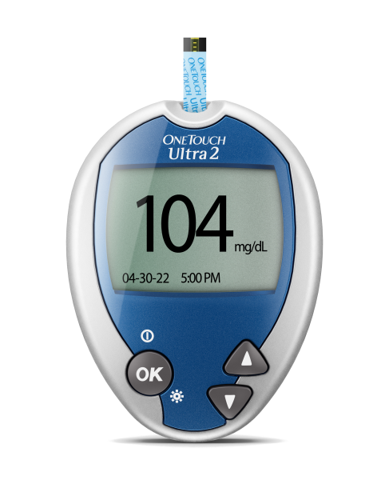
Example: Developing a new blood glucose meter

Slide 3
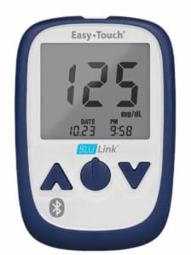
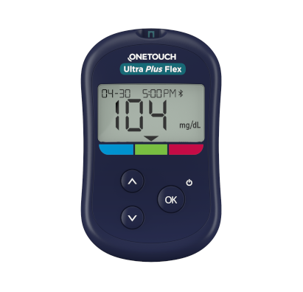
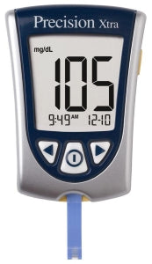

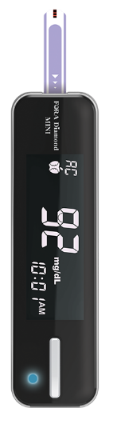

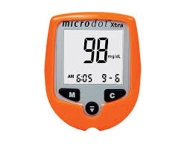
Learn about use problems with existing devices

Slide 4



KPA process
Select sources
Collect and analyze data
Document findings

Slide 5
Step 1: Select sources
Public regulatory databases
FDA’s MAUDE database
Recall notices
Public safety publications
ECRI Medical Device Safety Reports
ISMP Medication Safety Alert Newsletters
Internal resources
Post-market surveillance data
Feedback from sales, trainers, etc.

Slide 6
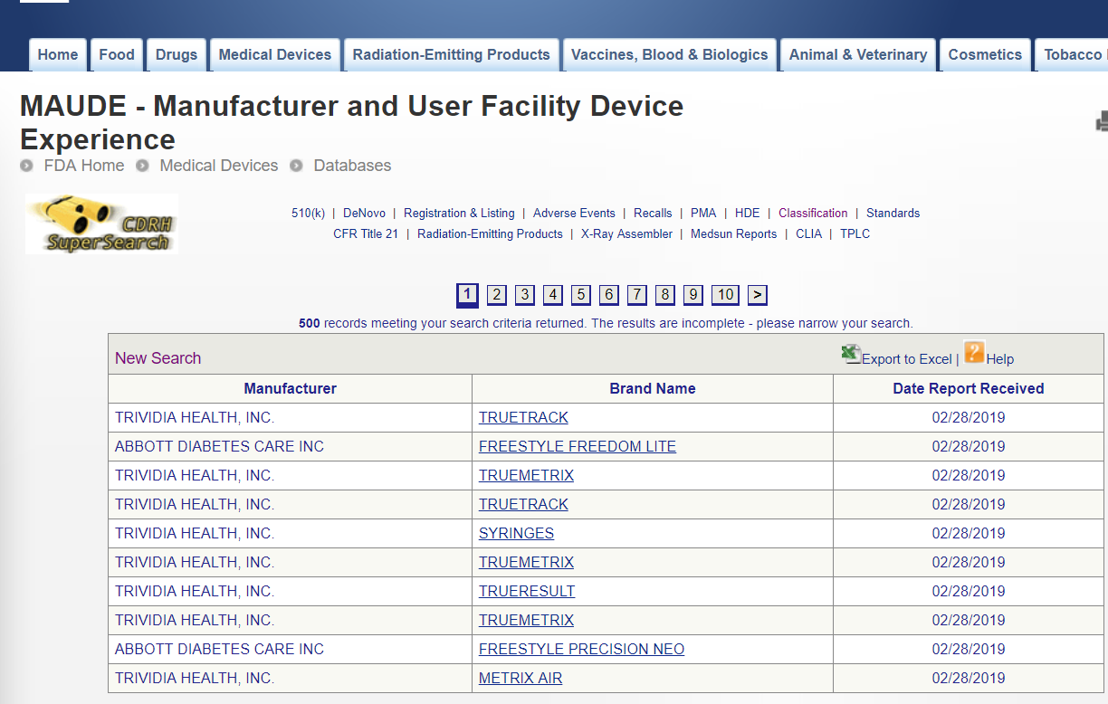

Step 2: Collect and analyze data

Slide 7
Step 3: Document findings
Concise description
Source
Mitigation
Known problem | Source | Mitigation
Applied blood droplet to strip prematurely. | MAUDE; report 2954323-2008-02271 | On-screen directions prompt user to add blood to test strip (using text and icons) at the appropriate time.
Did not apply blood to test strip correctly | MAUDE; report 2954323-2009-00280 | Test strips included in pack feature symbol showing user where to put blood.

Slide 8
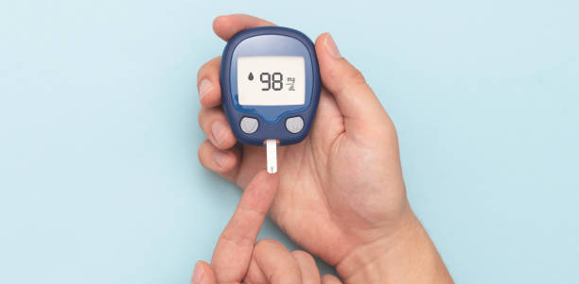

Next steps after performing a KPA
Ensure use-related risk analysis contains all findings
Identify mitigations for any new use-related issues

